Slide 1
Doctor's Client Management System
Full Stack Implimentations
James Mwangi

Slide 2
Project Overview
Goal: Create a user-friendly web interface for managing healthcare clients and their program enrollments.
Core Features: Dashboard Overview, Client CRUD, Program CRUD, Client-Program Enrollment Management, Client Search.
Target User: Doctor / Clinic Administrator.

Slide 3
Technology Stack
Backend: FastAPI (Python)
Database: MongoDB (via database.py)
Templating: Jinja2
Frontend: HTML5, CSS3, JavaScript (ES6+)
CSS Framework/Icons: None (Custom CSS), Boxicons
Key Libraries: python-dotenv

Slide 4
Architectural Approach
Pattern: Backend API (FastAPI) serving HTML templates (Server-Side Rendering with Jinja2).
Structure:
main.py: FastAPI routes, request handling, data fetching, template rendering.
templates/: Jinja2 HTML templates for UI views.
static/: CSS and JavaScript files for styling and interactivity.
database.py: Database interaction logic (abstracted).
Data Flow: Browser Request -> FastAPI Route -> Database -> Data Processing -> Jinja2 Template Rendering -> HTML Response -> Browser.

Slide 5
Design Philosophy & Goals
Clarity & Intuitiveness: Easy navigation, clear information hierarchy.
Consistency: Uniform look and feel across all pages (buttons, forms, tables, cards).
Responsiveness: Adaptable layout for various screen sizes (desktop, tablet, mobile).
User Experience (UX): Action confirmations (delete modal), clear feedback (status badges, empty states), logical workflows.
Visual Theme: Professional look with configurable Light/Dark modes, using orange (#ff6b00) as primary accent.

Slide 6
Core Layout (base.html)
Structure: Fixed Sidebar + Scrollable Main Content Area.
Sidebar:
Logo & Branding (DocCMS).
Collapsible Navigation (Boxicons + Text).
Active Link Highlighting (based on URL path).
Theme Toggle (Light/Dark) with localStorage persistence.
Top Bar:
Dynamic Page Title.
Contextual Action Buttons (e.g., "Add New Client").
(Mobile) Menu Toggle.
Content Area: Placeholder ({% block content %}) for page-specific content.

Slide 7
Styling Approach (style.css)
CSS Variables: Centralized control for colors, spacing, fonts, enabling easy theming and maintenance.
:root for Light Theme defaults.
.dark-mode class overrides for Dark Theme.
Layout: Flexbox and Grid for primary layout and component arrangement.
Component Styling: Reusable styles for Cards, Buttons, Forms, Tables, Modals, Badges.
Responsiveness: Media queries to adjust layout, font sizes, and element visibility (e.g., hiding sidebar text, showing mobile toggle).
Icons: Boxicons integrated directly in HTML, styled minimally where needed

Slide 8
Key UI Components
Cards: Consistent containers for grouping information.
Tables (.data-table): Displaying lists of clients, programs, enrollments with actions.
Forms: Standardized layout (.form-group, .form-row), clear labels, input styling.
Buttons: Different styles for primary/secondary actions, outlines, danger (delete). Action icons (.action-btn) for table rows.
Modals (.modal): Used for delete confirmations, preventing accidental data loss.
Status Badges: Visual cues for Active/Inactive status.

Slide 9
JavaScript Functionality (main.js, confirm-delete.js)
Theme Switching (main.js): Toggles .dark-mode class on <html>, updates button icon/text, saves preference to localStorage.
Sidebar Interaction (main.js): Handles collapsing/expanding on desktop, toggling visibility on mobile via a dedicated button.
Delete Confirmation (confirm-delete.js):
Generic modal handler attached to .delete-btn elements.
Uses data-* attributes to configure the modal (item ID, name, type).
Dynamically sets the action attribute of the modal's form.
Handles form submission via fetch, processes redirects or displays errors from the API response.

Slide 10

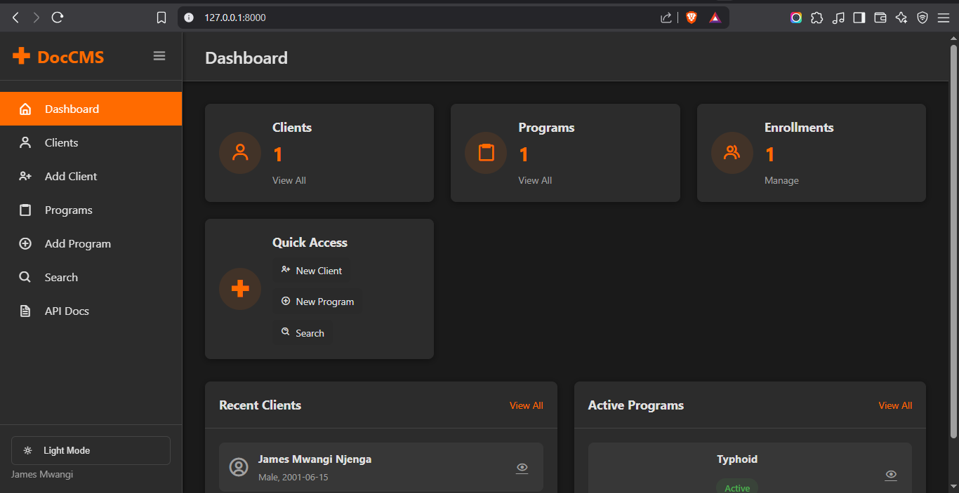
Page Examples (Screenshots/Live Demo Snippets)

Slide 11
Future Enhancements
Real-time Dashboard Updates (using WebSockets or polling /api/dashboard-data).
Advanced Search/Filtering (Date ranges, multiple criteria).
User Authentication & Authorization.
Reporting / Data Export features.
Input Validation (Client-side using JS, alongside server-side).
Accessibility improvements (ARIA attributes, keyboard navigation).

Slide 12
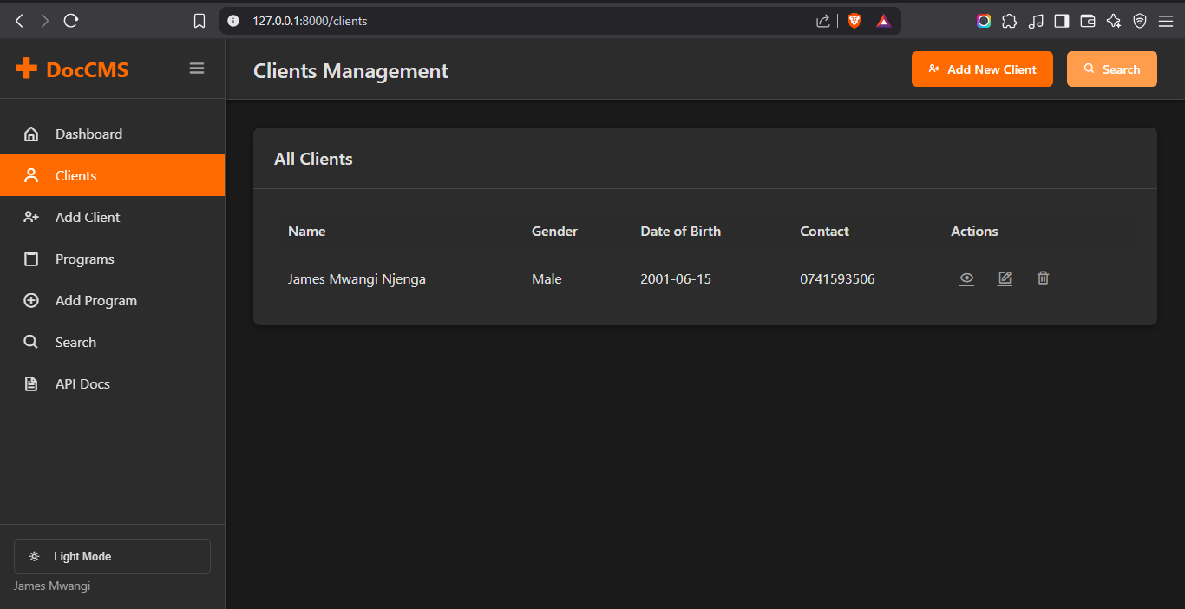

Slide 13
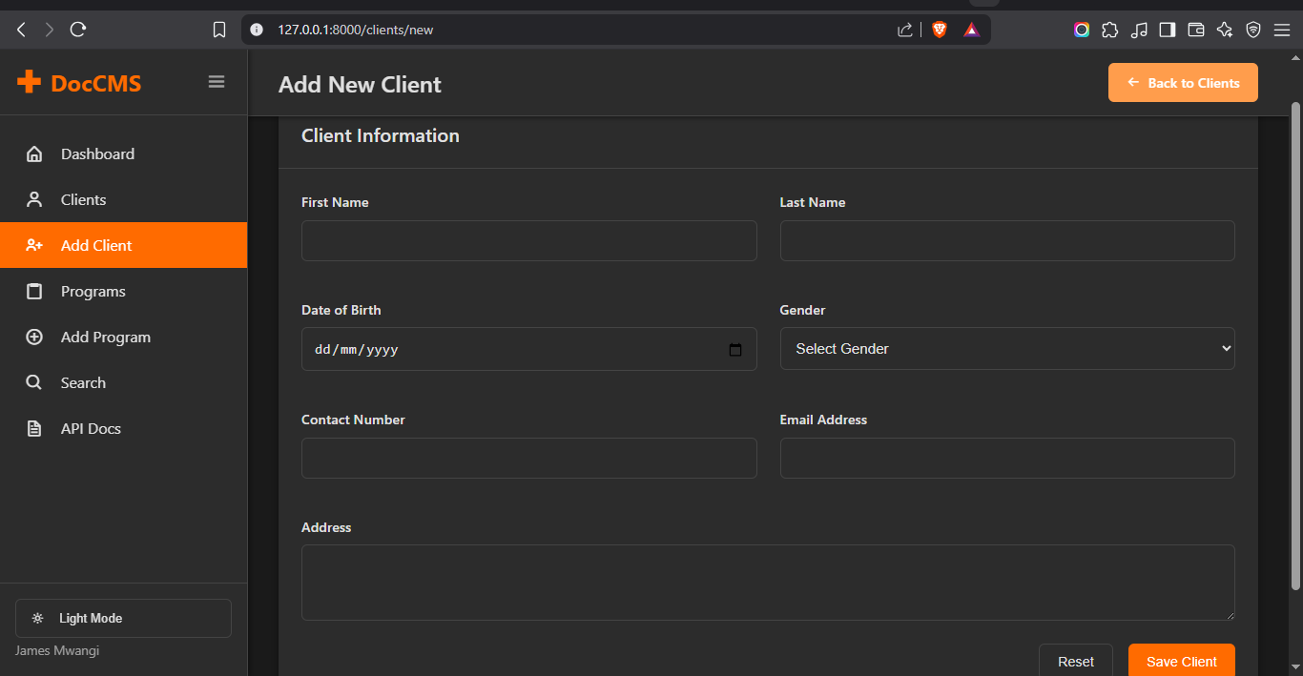

Slide 14
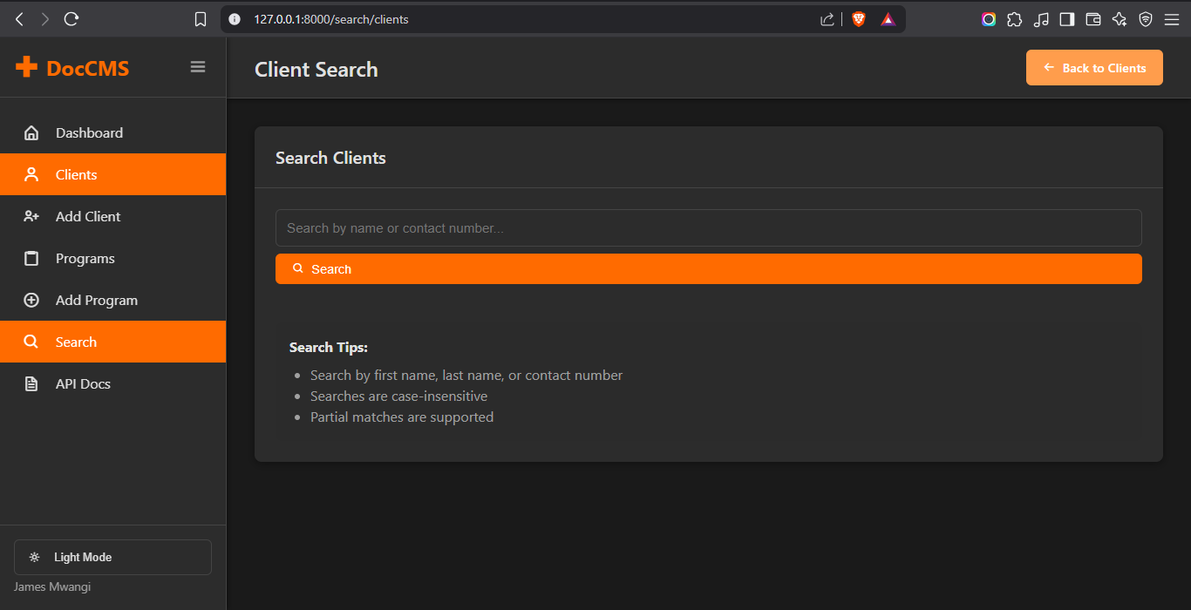

Slide 15
